Slide 1
Unit 11 Intermediate Code Generation

Slide 2
Summary
Three-Address Code
Code for Assignments
Code for Boolean Expressions
Code for Flow-of-Control Statements

Slide 3
Introduction
A source program can be translated into intermediate code by intermediate code generator
Intermediate code is machine-independent

Slide 4
Benefits of Intermediate Code
Retargetting is facilitated
A machine-independent code optimizer can be applied to intermediate representation

Slide 5
Intermediate Code
To be done by an Intermediate Code Generator.
Intermediate representation is decided by compiler designer
Typical intermediate representations are:
Syntax Tree
Postfix Notation
Three Address Code

Slide 6
Intermediate Code
As intermediate code we consider the three-address code, similar to assembly: sequence of instructions with at most three operands such that:
1. There is at most one operator, in addition to the assignment (we make explicit the operators precedence).
2. The general form is: x := y op z
x,y,z are called addresses, i.e. either identifiers, constants or compiler-generated temporary names.
Temporary names must be generated to compute intermediate operations.
Addresses are implemented as pointers to their symbol-table entries

Slide 7
Three Address Code of t: =x + y * z
t₁ := y*z
t := x+t₁

Slide 8
Types of Three-Address Statements
Three-Address statements are akin to assembly code: Statements can have labels
There are statements for flow-of-control.
1. Assignment Statements: x := y op z.
2. Unary Assignment Statements: x := op y.
3. Copy Statements: x := y.
4. Unconditional Jump: goto L, with L a label of a statement.
5. Conditional Jump: if x relop y goto L.

Slide 9
Types of Three-Address Statements
Procedure Call: param x, and call p,n for calling a procedure, p, with n parameters. return y is the returned value of the procedure:
param x₁
param x₂
. . .
param x_{n}
Call p,n
Indexed assignments: x := y[i] or x[i] := y. Note: x[i] denotes the value in the location i memory units beyond location x.

Slide 10
Syntax Directed Definition into Three Address Code
The synthesized S.code represents the three address code
Template names are generated for intermediate calculations
The nonterminal E has two attributes
E.place the name that will hold the value of E
E.code the sequence of three-address statements evaluating E
The function newtemp returns a sequence of distinct names t1, t2,. .
The function gen generates three-address code such that:
1. Everything quoted is taken literally;
2. The rest is evaluated.
In practice, code can be sent to an output file instead of being assigned to the code attribute.

Slide 11
SDD to Produce Three Address Code for Assignments
Productions Semantic Rules
S → id := E {S.code = E.code||gen(id.place ‘:=’ E.place)}
E → E₁ + E₂ {E.place= newtemp ;
E.code = E₁.code || E₂.code ||
|| gen(E.place‘:=’E₁.place‘+’E₂.place) }
E → E₁ * E₂ {E.place= newtemp ;
E.code = E₁.code || E₂.code ||
|| gen(E.place‘:=’E₁.place‘*’E₂.place) }
E → - E₁ {E.place= newtemp ;
E.code = E₁.code ||
|| gen(E.place ‘:=’ ‘uminus’ E₁.place) }
E → ( E₁ ) {E.place= E₁.place ; E.code = E₁.code}
E → id {E.place = id.place ; E.code = ‘’ }

Slide 12
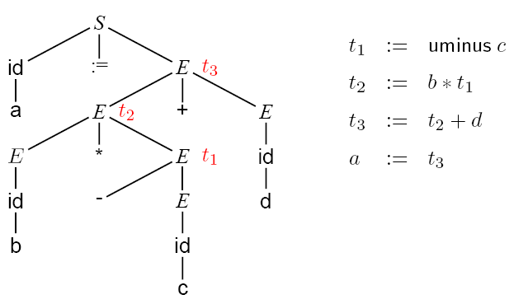
Three Address Code of a := b * -c + d

Slide 13
Implementation of Three Address Statements
Quadruples
t₁:=- c
t₂:=b * t₁
t₃:=- c
t₄:=b * t₃
t₅:=t₂ + t₄
a:=t₅
 | op | arg1 | arg2 | result
(0) | uminus | c |  | t₁
(1) | * | b | t₁ | t₂
(2) | uminus | c |  | t₃
(3) | * | b | t₃ | t₄
(4) | + | t₂ | t₄ | t₅
(5) | := | t₅ |  | a
Template names must be inserted into the symbol table when they are generated.

Slide 14
Implementation of Three Address Statements
 | op | arg1 | arg2
(0) | uminus | c
(1) | * | b | (0)
(2) | uminus | c
(3) | * | b | (2)
(4) | + | (1) | (3)
(5) | assign | a | (4)
Triples
t₁:=- c
t₂:=b * t₁
t₃:=- c
t₄:=b * t₃
t₅:=t₂ + t₄
a:=t₅
Template names are not inserted into symbol tables

Slide 15
More Triple Representations
Example x[i]:=y x:=y[i]
Use triple structures
 | op | arg1 | arg2
(0) | [ ] | x | i
(1) | := | (0) | y
 | op | arg1 | arg2
(0) | [ ] | y | i
(1) | := | x | (0)

Slide 16
Implementation of Three Address Statements
Indirect triples is considered a listing of pointers to triples.
 | op
(0) | (14)
(1) | (15)
(2) | (16)
(3) | (17)
(4) | (18)
(5) | (19)
 | op | arg1 | arg2
(14) | uminus | c
(15) | * | b | (14)
(16) | uminus | c
(17) | * | b | (16)
(18) | + | (15) | (17)
(19) | assign | a | (18)

Slide 17
Intermediate Code for Declarations
offset is a global variable can keep track of the next available relative address.
Attribute Type represent a type expression constructed from basic types,
attribute Width indicate number of memory units taken by object of that type
Productions Semantic Rules
P → M D { }
M → ε {offset:=0 }
D → D; D
D → id : T { enter(id.name, T.type, offset)
offset:=offset + T.width }
T → integer {T.type = integer; T.width = 4 }
T → real {T.type =real; T.width = 8 }
T → array [ num ] of T₁
{T.type=array(1..num.val,T₁.type) T.width = num.val * T₁.width}

Slide 18
Keeping track of scope information
In a language with nested procedure, when a nested procedure is seen, processing of declarations in the enclosing procedure is temporarily suspended
Grammar for this type of declaration:
P → D
D → D; D | id : T | proc id ; D ; S
should be added more semantic rules
A new table is created when a procedure declqration D→ proc id D1; is seen

Slide 19
Nested procedures for quick sorting
Program sort;
Var a: array[0..10] of integer;
x: integer;
Procedure readarray;
Var i: integer;
Begin …a… end {readarray};
Procedure exchange(i, j: integer);
Begin {exchange} end;
Procedure quicksort(m, n: integer);
Var k, v: integer;
Function partition(y,z: integer): integer;
Begin ..a..v..exchange(i,j) end; {partition}
Begin … end; {quicksort}
Begin … end; {sort}

Slide 20
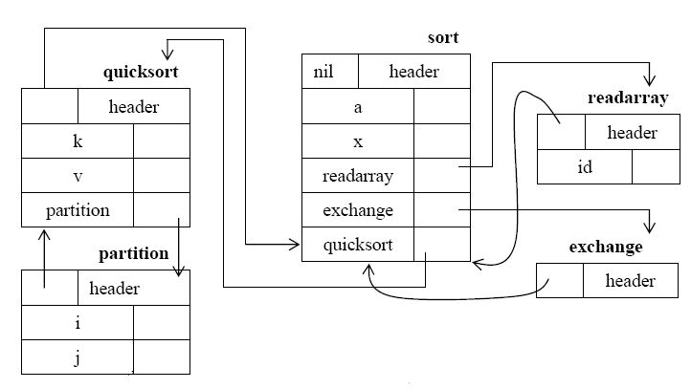
Five Symbol Tables of Sort

Slide 21
Procedures of semantic rules
mktable(previous) – creates a new symbol table and returns a pointer to the new table. The argument previous point to previously created symbol table.
enter(table,name,type,offset) – creates a new entry for name name in the symbol table pointed to by table,places type type and relative address offset in fields within the entry
enterproc(table,name,newbtable) – creates a new entry for procedure name in the symbol table pointed to by table. The argument newtable points to the symbol table for this procedure name
addwidth(table,width) – records the cummulative width of all the entries in table in the header associate with this symbol table.

Slide 22
Declaration Processing in Nested Procedures
P → M D { addwidth(top(tblptr), top(offset)); pop(tblptr); pop(offset) }
M → ε { t:=mktable(null); push(t, tblptr); push(0, offset)}
D → D₁ ; D₂
D → proc id ; N D₁ ; S { t:=top(tblpr); addwidth(t,top(offset));
pop(tblptr); pop(offset);
enterproc(top(tblptr), id.name, t)}
N → ε {t:=mktable(top(tblptr)); push(t,tblptr); push(0,offset);}
D → id : T {enter(top(tblptr), id.name, T.type, top(offset);
top(offset):=top(offset) + T.width

Slide 23
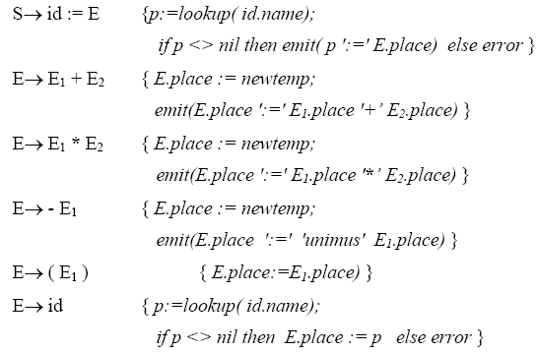
Syntax directed definition for assignment statements

Slide 24
Names in the symbol table
Names in an assignment generated by S must have been declared in either the procedure that S appears in or in some enclosing procedures.
The lookup operation first check if there is an entry for attribute id.name in the symbol table. If so, a pointer to the entry is returned. If the name cannot be found, then lookup returns nil.
Emit procedure used to emit three-address statements to an output file rather than building up code attributes for some nonterminals. Translation can be done by emitting to an output file if the code attributes of the nonterminals on the left sides of productions are formed by concatenating the code attributes of the nonterminals on the right side, perhaps with some additional strings in between

Slide 25
Names in the symbol table (cont’d)
Consider productions: D → proc id; ND₁; S
Names in an assignment generated by S must have been declared in either the procedure that S appears in or in some enclosing procedure.
When apply to name, lookup operation checks if name appears in the current symbol table accessible through top(tblptr). If not, lookup uses the pointer in the header of the table to find the symbol table for the enclosing procedure and looks for the name there. If the name cannot be found in any of these scopes, lookup will return nil

Slide 26
Addressing array element
Elements of an array can be accessed quickly if the elements are stored in a block of consecutive locations. If the width of each array element is w then the i^{th} element of array A begins in location:
A[i] = base + (i-low)*w
Where:
Low is the lower bound of the subscript
Base is the relative address of the storage allocated for the array(the relative address of A[low])
A[i] = i*w + (base – low*w)
Where c = base – low*w can be evaluated when the declaration of the array is seen. Assume c is saved in the symbol table entry for A,
⇒ A[i] = i*w + c

Slide 27
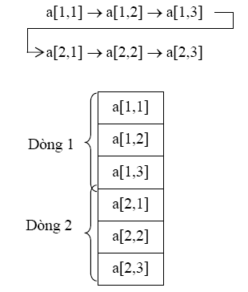
Layouts for a two dimensional array
By row
Relative address of A[i₁,i₂] =
base + ((i₁ – low₁)*n₂ + i₂ – low₂)*w
low₁, low₂: lower bound of i₁ và i₂
n₂: the number of values that i₂ can take. If high₂ is upper bound of i₂ then n₂ = high₂ – low₂ + 1

Slide 28
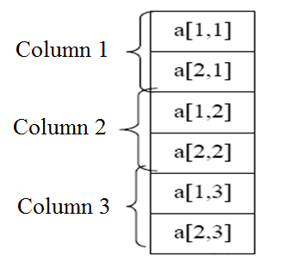
Layouts for a two dimensional array
By column

Slide 29
Boolean Expressions
Boolean Expressions are used to either compute logical values or as conditional expressions in flow-of-control statements.
We consider Boolean Expressions with the following grammar:
E → E or E | E and E | not E | (E) | id relop id | true | false
There are two methods to evaluate Boolean Expressions
1. Numerical Representation. Encode true with ’1’ and false with ’0’ and we proceed analogously to arithmetic expressions.
2. Jumping Code. We represent the value of a Boolean Expression by a position reached in a program.

Slide 30
Numerical Representation of Boolean Expressions
Expressions will be evaluated from left to right assuming that: or and and are left-associative, and that or has lowest precedence, then and, then not
Example 1: The translation for a or b and not c is
t1 = not c
t2 = b and t1
t3 = a or t2
A relational expression such as a<b is equivalent to the conditional statement if a<b then 1 else 0 and its translation involves jumps to labeled statements:
Example 2
100: if a<b goto 103
101: t:=0
102: goto 104
103: t:= 1
104:

Slide 31
Jumping Code for Boolean Expressions
The value of a Boolean Expression is represented by a position in the code.
Consider Example 2: We can tell what value t will have by whether we reach statement 101 or statement 103.
Jumping code is extremely useful when Boolean Expressions are in the context of flow-of-control statements.

Slide 32
Translating Boolean expressions
If E has form : a<b the the code generated is
If a<b then goto E.true else goto E.false
If E has form: E1 or E2 then
If E1 is true then E is true
If E1is false then evaluate E2; Value of E is true or false depends onE2
Similarly for E1 and E2

Slide 33
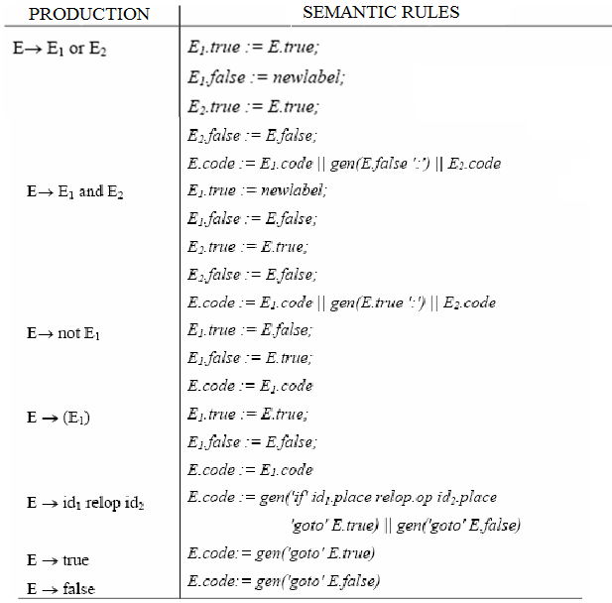
Translating Boolean expressions

Slide 34
Flow-of-Control Statements
In the translation, we assume that a three-address code statement can have a symbolic label, and that the function newlabel generates such labels.
We associate with E two labels using inherited attributes:
1. E.true, the label to which control flows if E is true;
2. E.false, the label to which control flows if E is false.
We associate to S the inherited attribute S.next that represents the label attached to the first statement after the code for S.

Slide 35
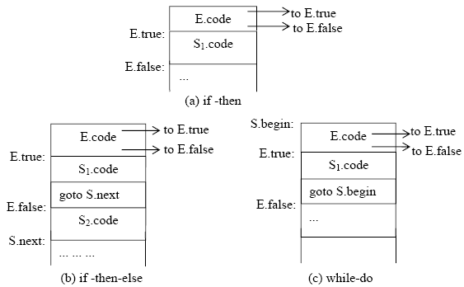
Flow of Control Statements

Slide 36
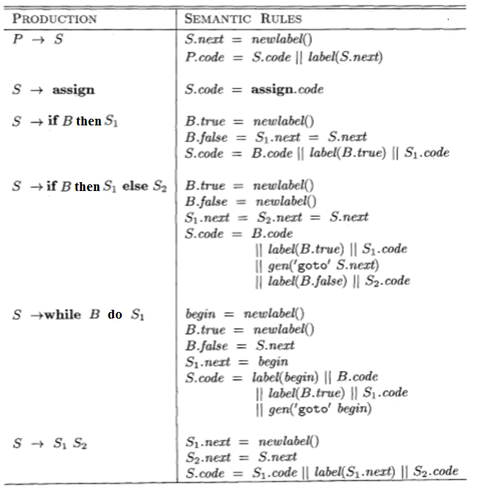
SDT for flow of control statements

Slide 37
Example
Translate the following statement:
while a < b do
if c < d then
x := y + z
else
x := y - z

Slide 38
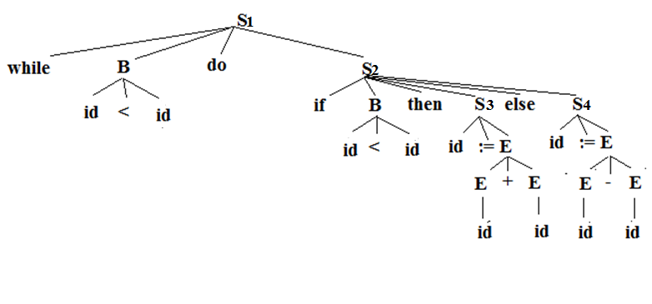
Parse Tree of St

Slide 39
Attributes
id.place: z

Slide 40
Attributes
E.place =z
E.code=“”

Slide 41
Attributes
E.place = newtemp() t1
E.code= “t1=y-z”

Slide 42
Semantic rules
S → id := E { S.place=id.place
S.code = E.code||gen(S.place ‘:=’ E.place) }
Attributes
S.place=id.place = x
S.code= “t1=y-z
x=t1”

Slide 43
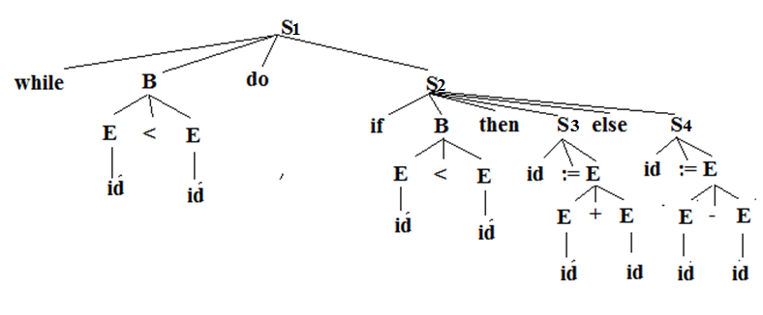

Semantic rules
Attribute
.code
if c < d goto L1
Goto L2

Slide 44
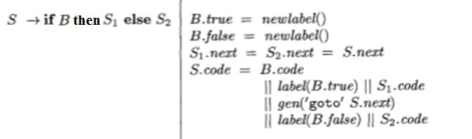
Semantic rules
Attributes
B.true = newlabel() -> L1
B.false= newlable() -> L2
S1.next=s2.next=s3.next
S.code
if c < d goto L1
goto L2
L1: t1= y + z
x = t1
goto S.next
L2:t2 = y – z
x = t2

Slide 45
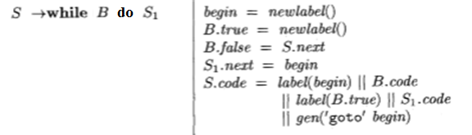
Semantic rules
Attributes
begin = newlabel() -> L3
B.true= newlabel() -> L4
B.False = S.next
S1.next = begin = L3 => S2.next = S3.next = L3
S.code
L3: if a< b goto L4
goto L0
L4: if c < d goto L1
goto L2
L1: t1= y + z
x = t1
goto L3
L2:t2 = y – z
x = t1
goto L3
Label L0 will appear in the intermediate program after generating code using semantic rules of production S → S₁S₂

